Slide 1
Client query management system

Slide 2
Agenda
Introduction
Features
Tech Stack
Screen Shots

Slide 3

introduction
Streamlit-based ticket management system
Clients submit queries
Support team manages and closes tickets
Admin monitors data with date filters and charts
PostgreSQL used as backend database

Slide 4

features​
Login & Registration System
Query Submission (Client Side)
Support Team Dashboard

Slide 5
Tech Stack
Frontend : Streamlit
Backend : Python
Database : PostgreSQL
Libraries : Pandas, Matplotlib & hashlib

Slide 6
Screen shots

Slide 7
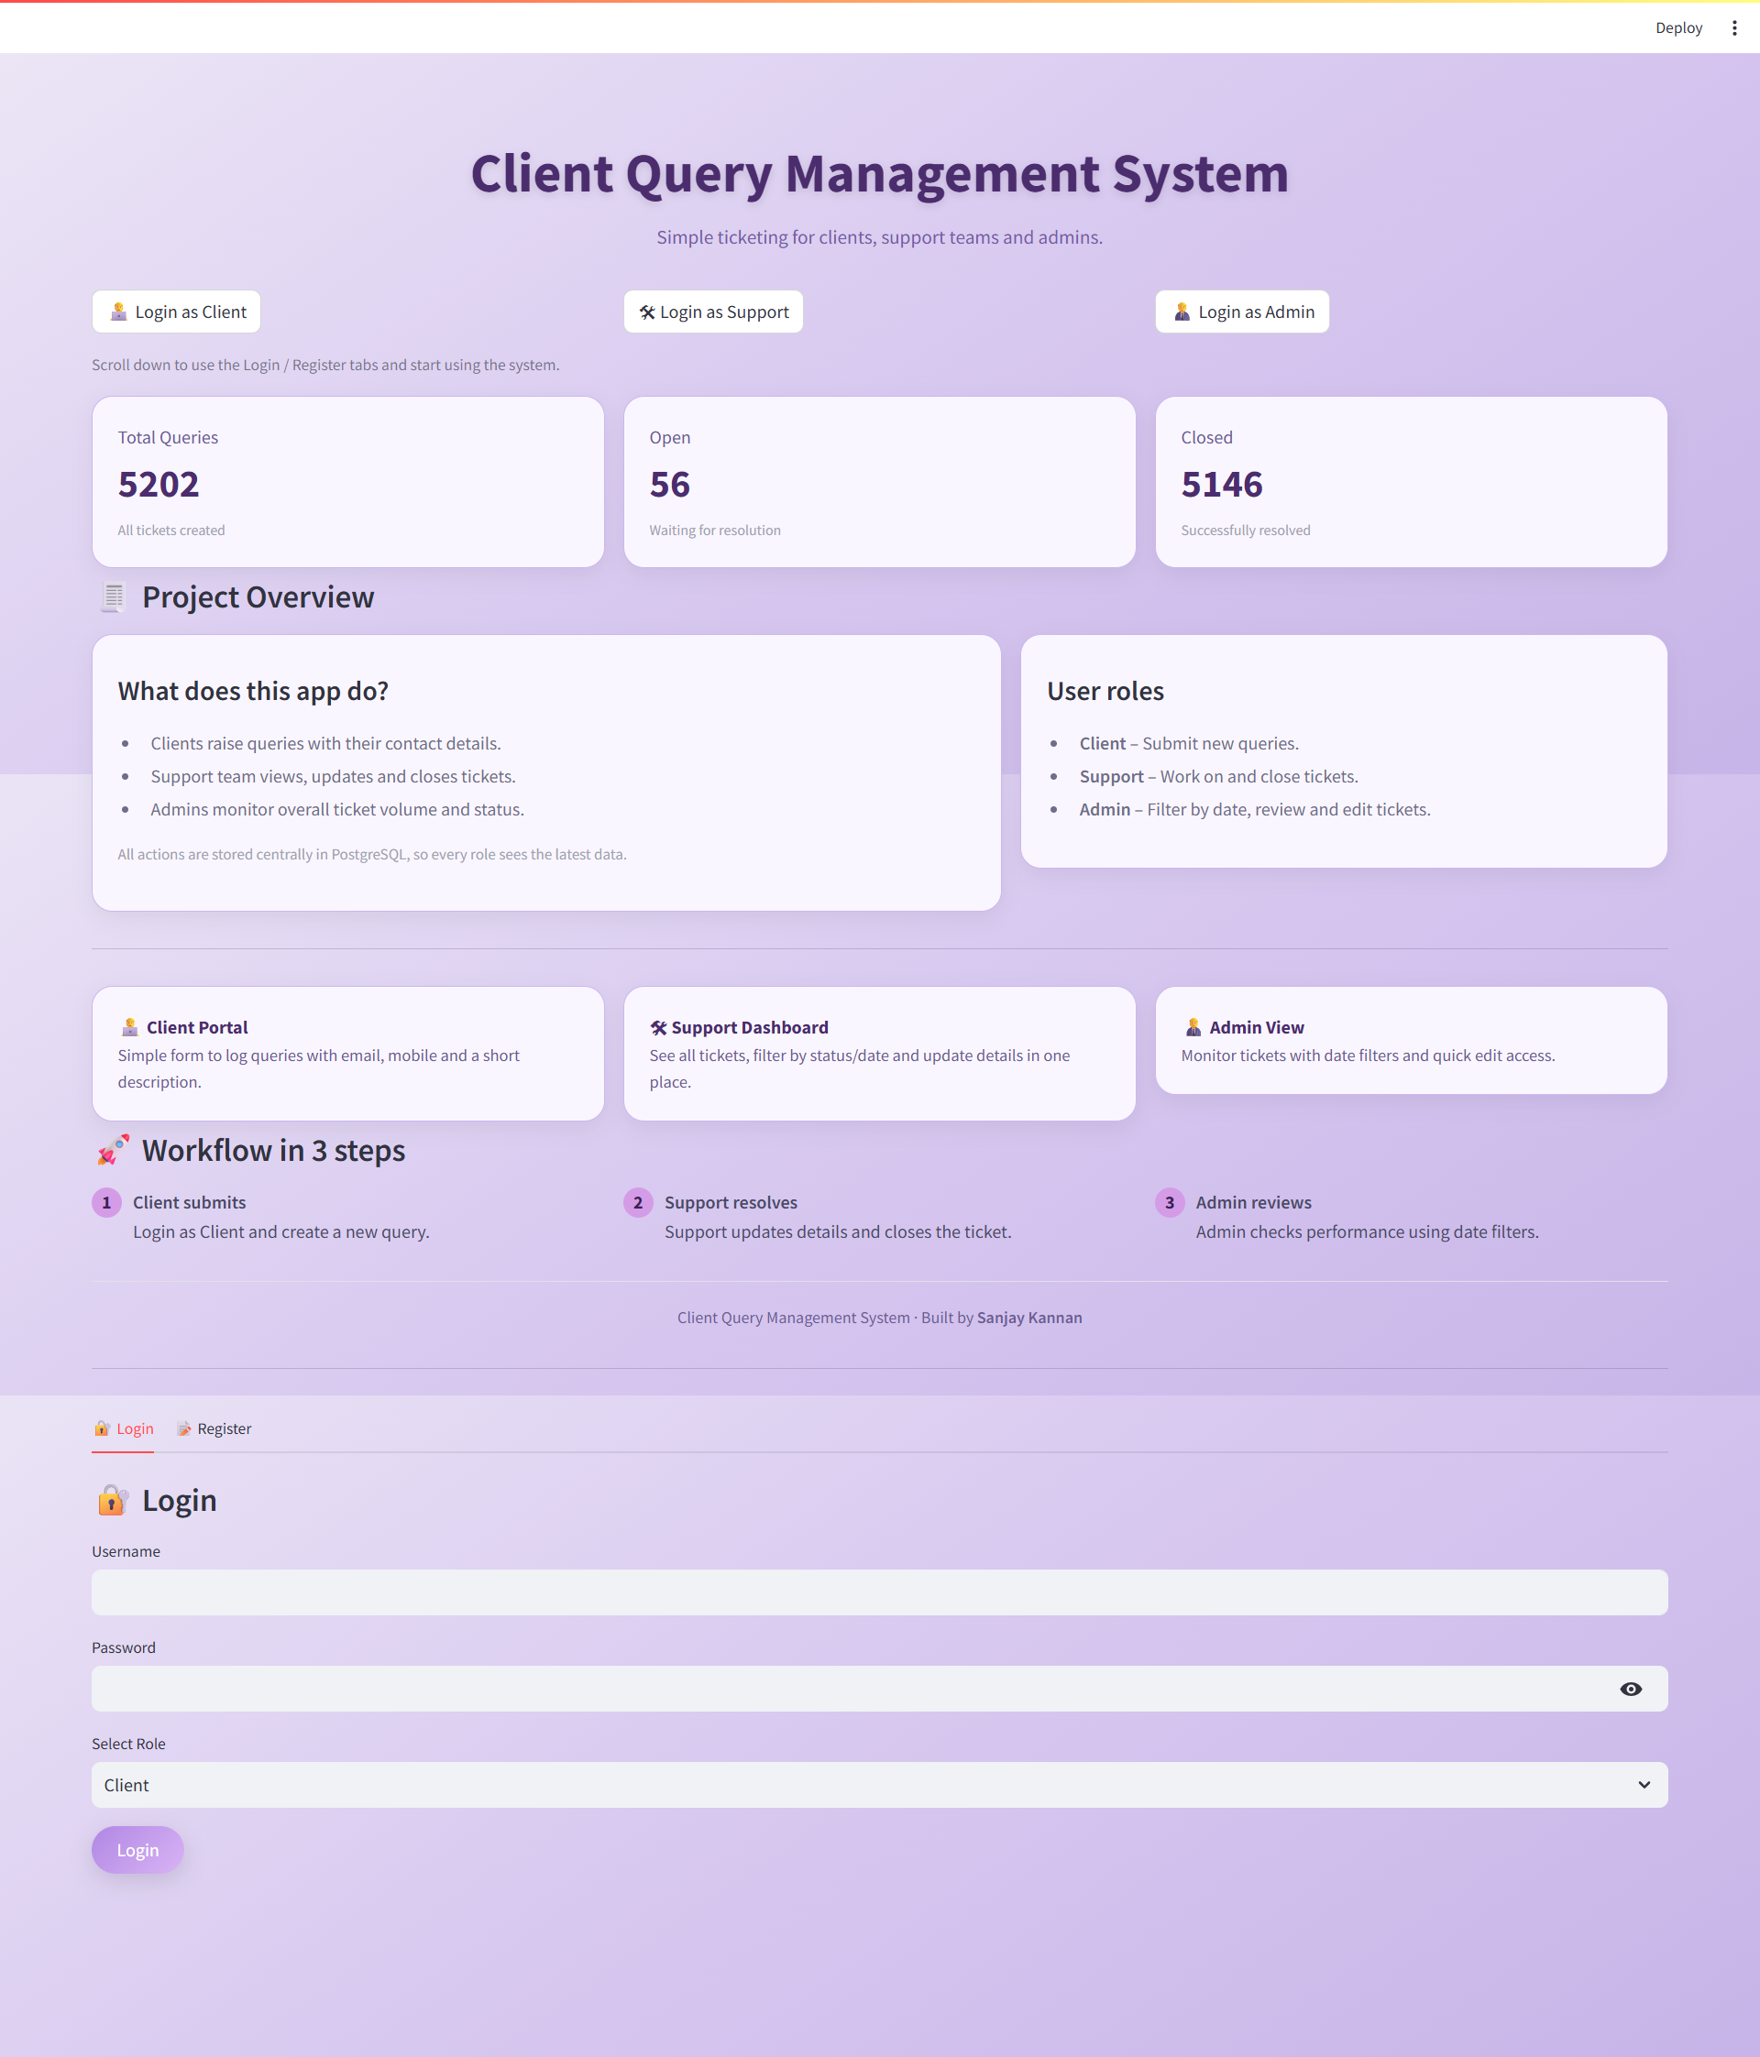
Project Overview

Slide 8
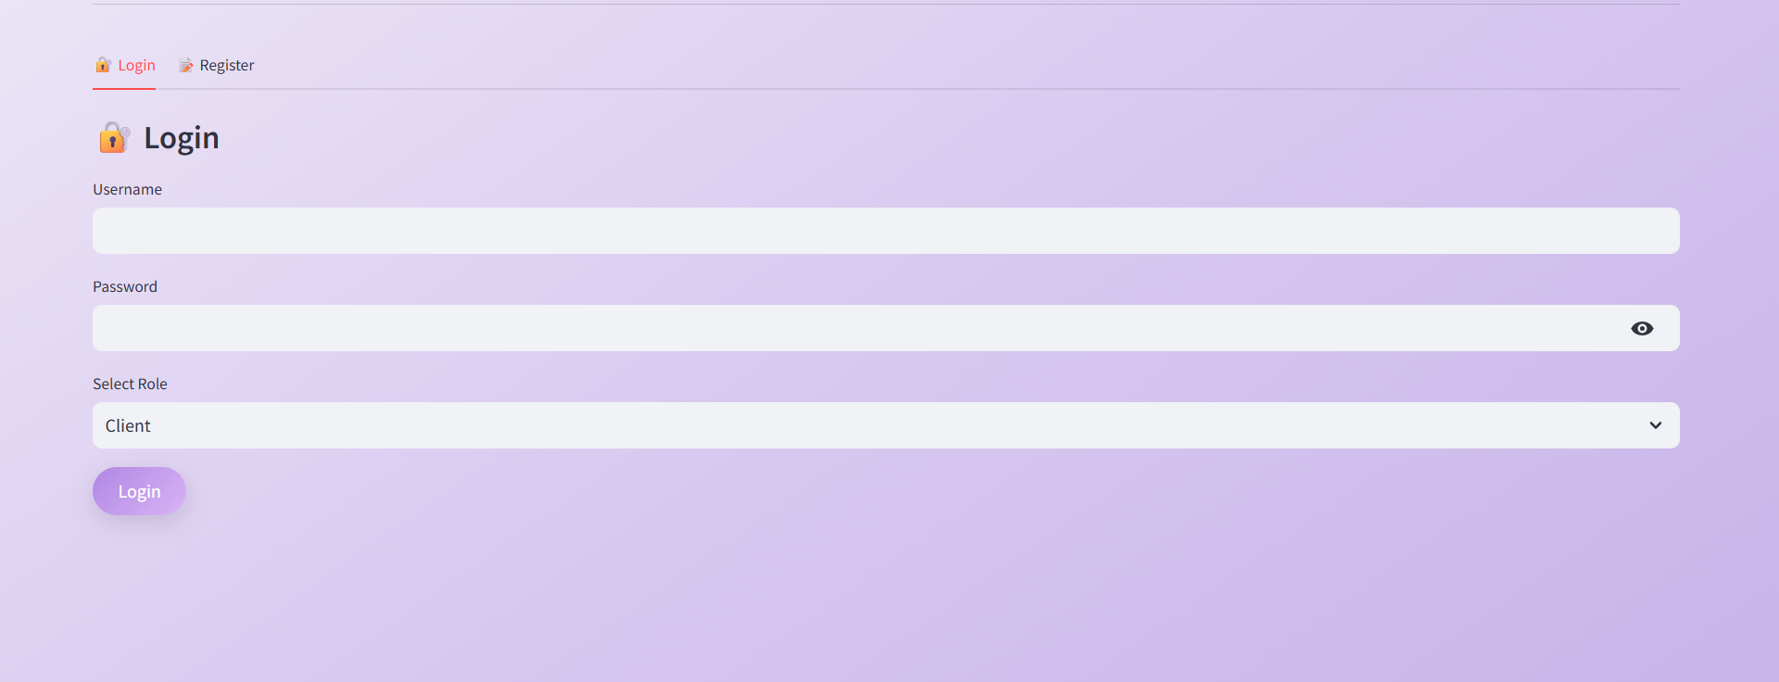
Login page​

Slide 9
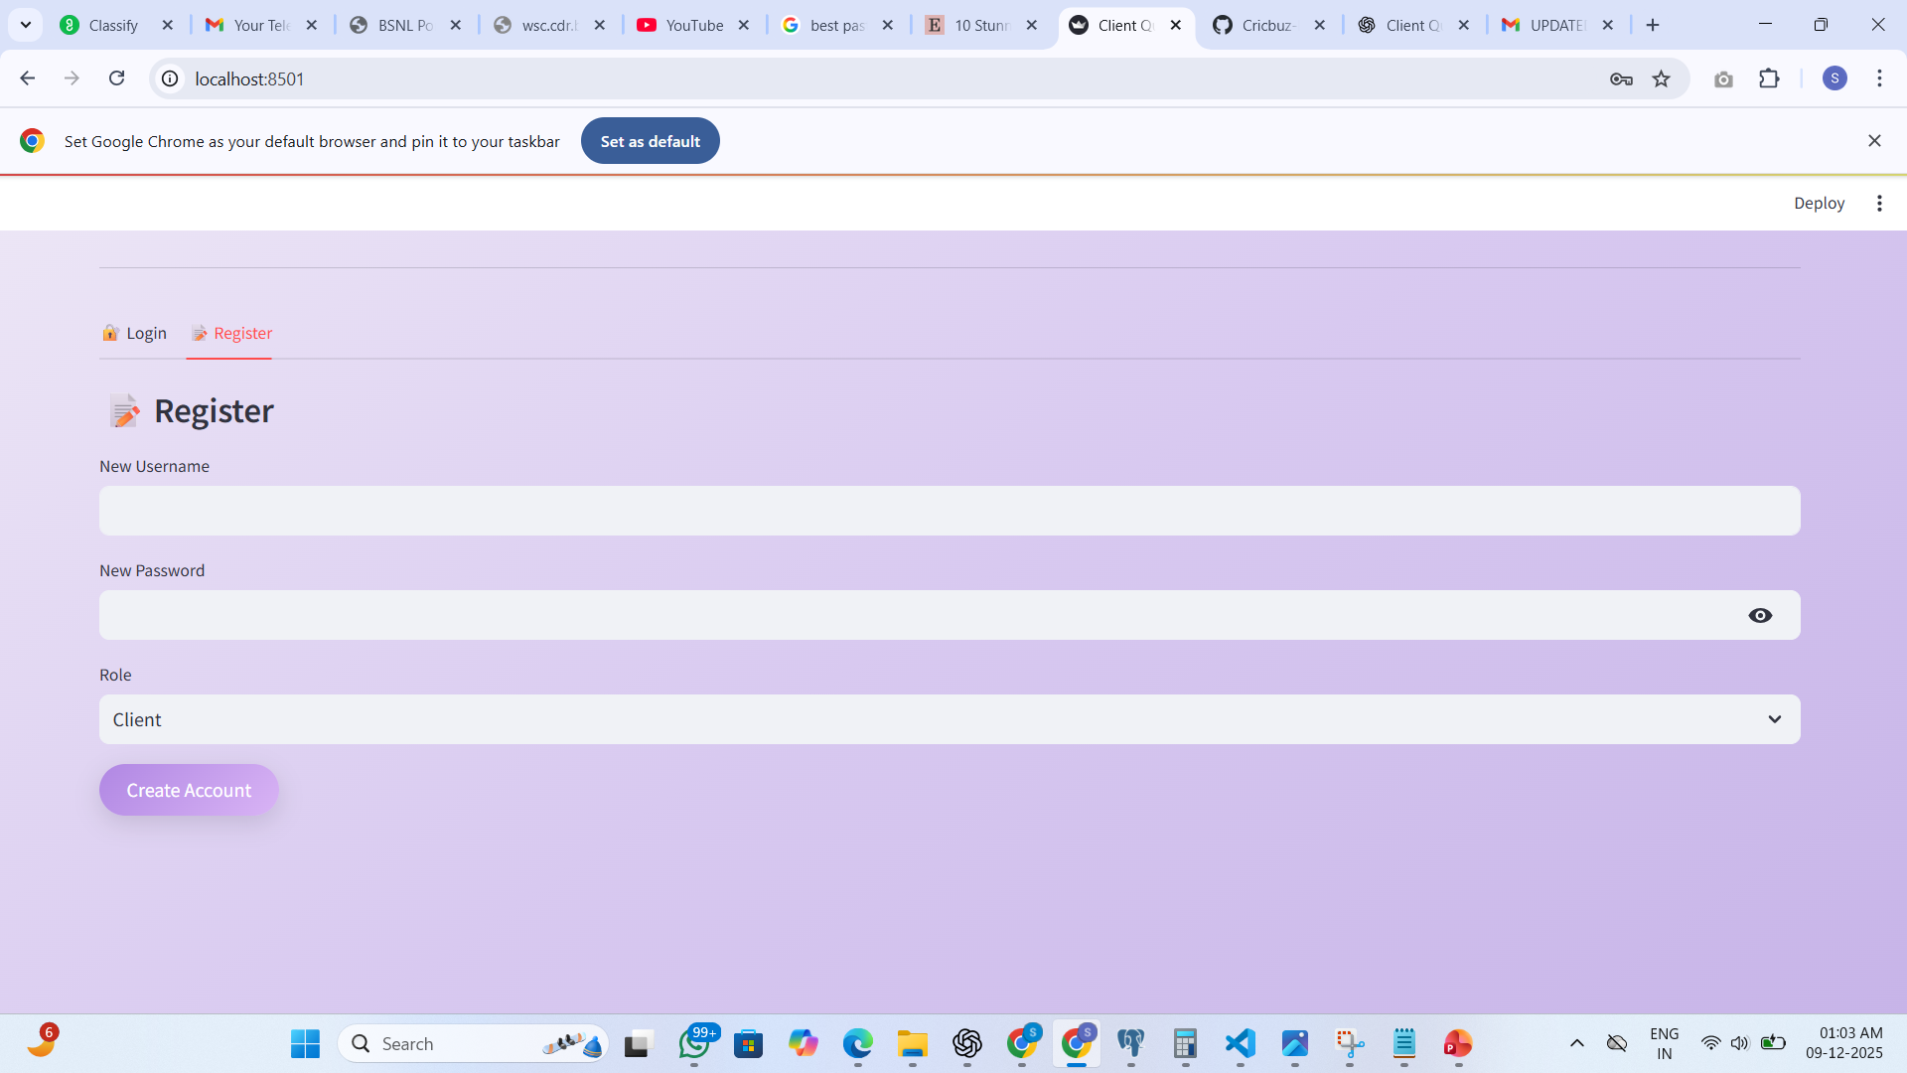
register page

Slide 10
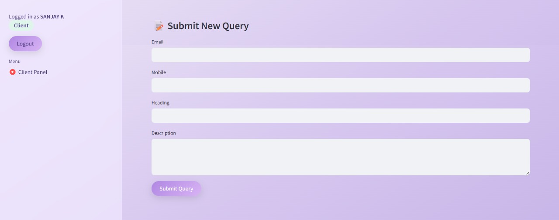
Client query page

Slide 11

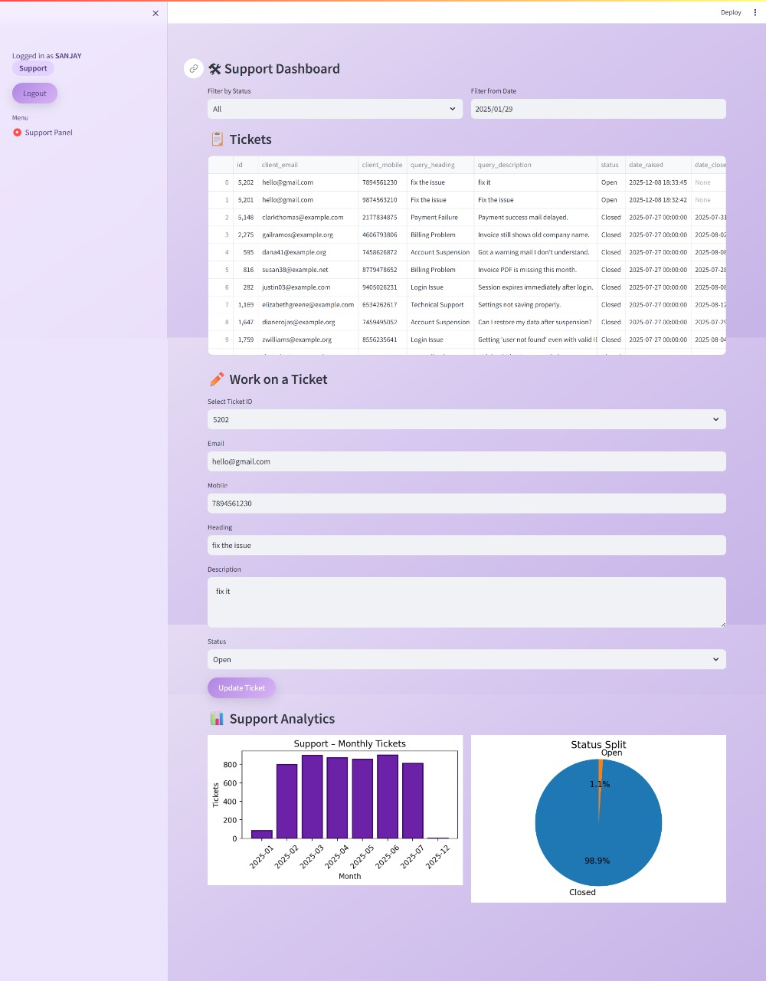
Support page​

Slide 12
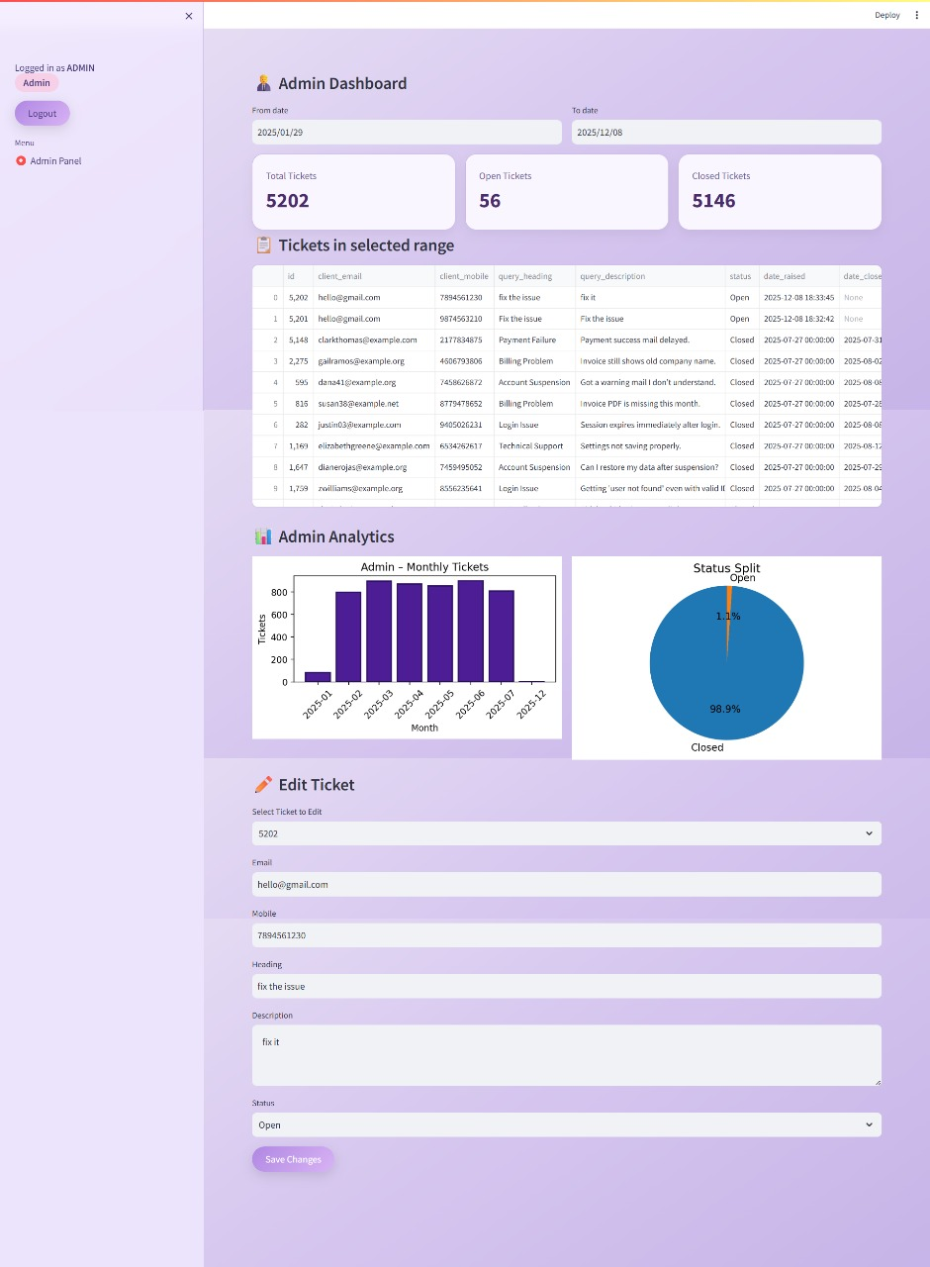
Admin page​

Slide 13
Thank You!
Client Query Management System
Developed by
Sanjay kannan

